Slide 1


Slide 2

AVEVA is a leader in industrial digital transformation
AVEVA has come together with OSIsoft, unifying world-leading operational data management with our industrial software
FTSE 100 listed on the London Stock Exchange
Schneider Electric is a 60% shareholder and strategic partner
Growing recurring revenue and margins
Cloud growth accelerated with an increase of over nearly 200% in TCV YoY
Market capitalization > US $13BN
Revenue > US $1.6BN
Notes:
AVEVA is a world leader in industrial software. Our business is founded in trusted partnerships with our customers: leading industrial companies across the globe who use our expertise and our products to unify their data and combine it with leading-edge analytics, so that they can turn opportunities into sustainable business value.
We have recently merged with OSIsoft, bringing together the world-leading operational data management of the PI System with our innovative industrial software, to empower your teams and enable even higher levels of performance. We call the power of our combined business "performance intelligence" and I'll explain more about this later on.
With over 50 years of innovation and 2 million licenses installed, AVEVA holds a leading market position in diverse markets and industrial software sectors worldwide. Our proven, trusted solutions are founded on deep industry understanding that can help to realize tangible benefits quickly for our customers. Together with our ecosystem of 5,500 partners and system integrators, we are proud to help drive digital transformation and deliver tangible benefits for the world’s most complex and innovative industries.
We are committed to developing and growing our expertise, with an ongoing investment of over £175 million each year in research and development.
We are listed on the London Stock Exchange and part of the FTSE100. We have a market cap of over $20 billion with annual revenues of over US$ 2 billion. Our partner, Schneider Electric, holds 60% of AVEVA stock.
[Only if relevant - While our software is agnostic, we can leverage the breadth and depth of Schneider Electric’s services network when we need to, to deliver swift, effective innovation for shared customers.]

Slide 3
We offer a powerful combination of technology and teamwork
10+
R&D Centers
22+
Project Centers
2,000+
R&D Capacity
16%
of Revenue reinvested in R&D
85%
Projects include
Next-Gen tech
6,500
Employees
4,300
SI Partners
120+
Sales Partners
250+
Tech Partners
20+
Alliance Partners​
Project Center
R&D Center
Combined R&D
and Project Center
Notes:
Here you can see the breadth and scope of our network, our 6,500 employees and our 5,500 partners who form our truly global ecosystem.
You can also see the scope and depth of our R&D investment, with ten R&D hubs and 20 project centers and more than 2,000 people employed in driving innovation across the company.
Each year we reinvest around 16% of our revenue in the business, helping to drive innovation forward to stay ahead of the curve for your business. Indeed at any one time, some 85% of customer deployments are directly benefitting from AVEVA R&D programs and extensions.
In addition, our capabilities are extended and deepened by our ecosystem. Our customer benefit from our network of more than 4,500 system integrators, over 120 sales partners and distributors, and more than 350 tech partners. We also maintain strategic alliances with about 20 of the world's leading technology companies: companies like Microsoft, Accenture, and of course our strategic partner [and majority shareholder], Schneider Electric.

Slide 4
Accelerating the digital transformation of the industrial world
AVEVA and OSIsoft unite world-class operational data management with leading industrial software
1
2
3
AVEVA and OSIsoft combine
to deliver
Performance Intelligence
AVEVA continues its journey to become the leading industrial software provider, in partnership with Schneider Electric
Our plan is to deliver exceptional value to partners and customers to shape a sustainable future
Notes:
Our acquisition of OSIsoft unites the world's leading operational data management platform -- the PI System -- with AVEVA's market-leading industrial software.
By unifying the power of information with artificial intelligence and human insight, we believe we can drive Performance Intelligence for industries worldwide.
Let's talk about what that means for your business...

Slide 5
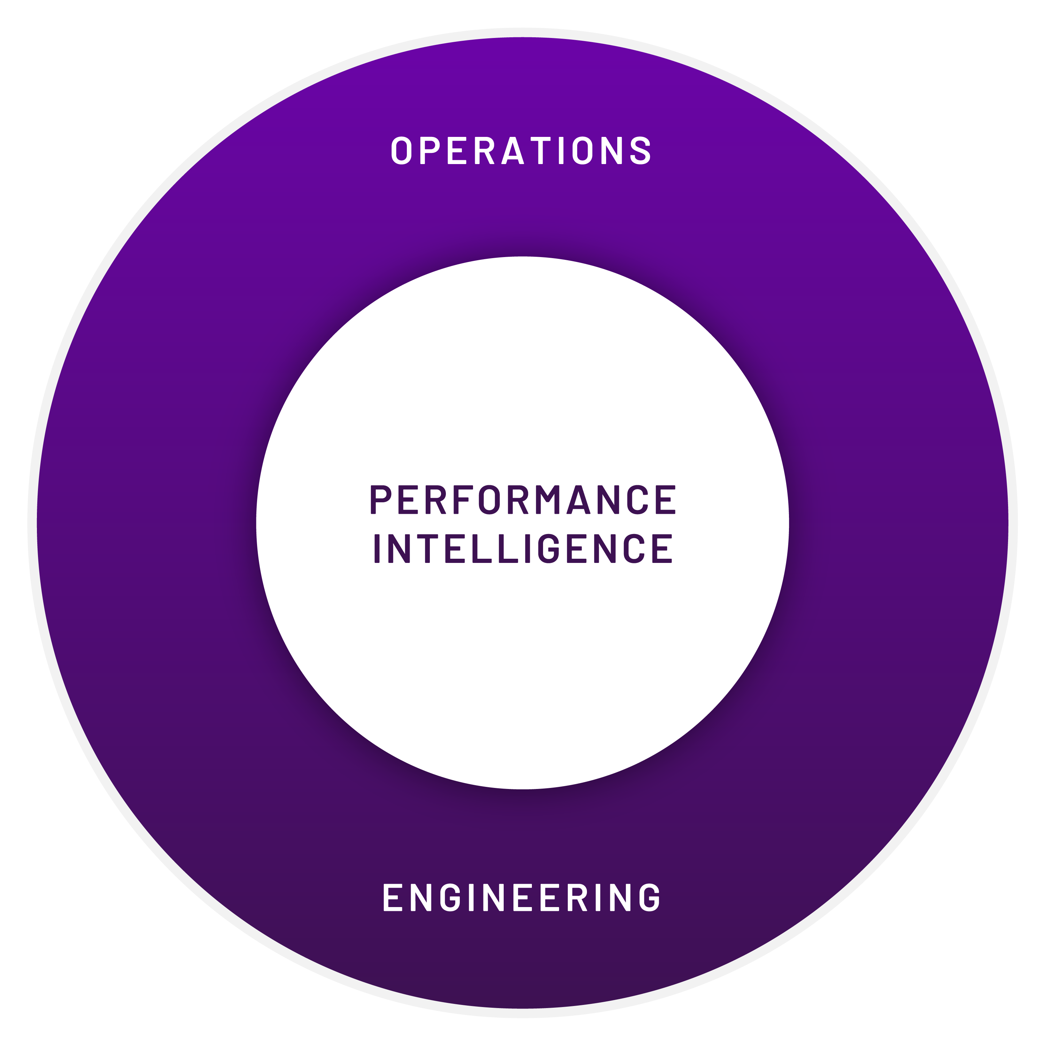





Harnessing the power of information, AI and human insight
Two world class industrial software experts combine to deliver integrated value
+
AVEVA’s end-to-end industrial software to optimize engineering and operations
OSIsoft’s PI System is the industry standard for industrial information management
1
Run agile, continuously optimized operations to protect the bottom line
2
Increase asset reliability and safety with reduced manual supervision
3
Provide remote teams rich data and decision support to collaborate and work efficiently
4
Maximize CapEx and drive the highest levels of engineering efficiency
Automation/
Control Systems
New Sensor
Tech
Remote + Mobile
Assets
Notes:
When it comes to advancing industries in changing times, you need performance that’s faster, deeper, sharper and more accurate to realize sustainable growth. By leveraging the most precise, optimized intelligence, you can lead the way. This is why we at AVEVA believe that Performance Intelligence is key to unlocking your success in the connected industrial economy.
Performance Intelligence is about combining the power of analytics with human insight, giving your teams the rich, reliable data they need to engineer bigger, operate better and achieve more. Unifying the world-class industrial information management of the PI System with AVEVA's leading industrial software, we enable collaborative innovation that empowers people and helps industries thrive.
Both AVEVA and OSIsoft were founded on open and agnostic values. Together, we’re committed to working with you and harnessing the power of our ecosystem to drive agility from engineering to operations. Like never before, we’re uniting industrial software to give you the Performance Intelligence you need to shape a sustainable future.
Performance Intelligence is about ensuring that your teams have:
-Better, more accurate and reliable data enriched with scope and scale of information
-Smarter solutions which are software agnostic, and which you can plug into your existing systems within days
-The confidence, trust and expertise of knowing that you are selecting software that delivers proven outcomes and the agility your business needs.
Using the power of our capabilities you can boost asset reliability and safety, with increased automation to drive efficiency. You can support remote teams with real-time data and analytics that boosts collaboration and more precise decision making so that you can elevate your performance. As a result, you can maximize capex efficiency and drive operational efficiencies throughout the engineering and operations lifecycle.

Slide 6






















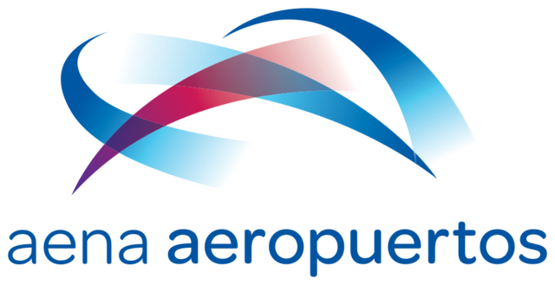


































Our software drives transformation for 20,000 customers
Energy
Power
Food, Bev, CPG, Life Sciences
Chemicals
Infrastructure
Mining
Marine
EPC
Notes:
On this chart, you can see just a few of the 20,000 companies across diverse industrial market segments who trust AVEVA’s solutions to transform their assets and operations.

Slide 7

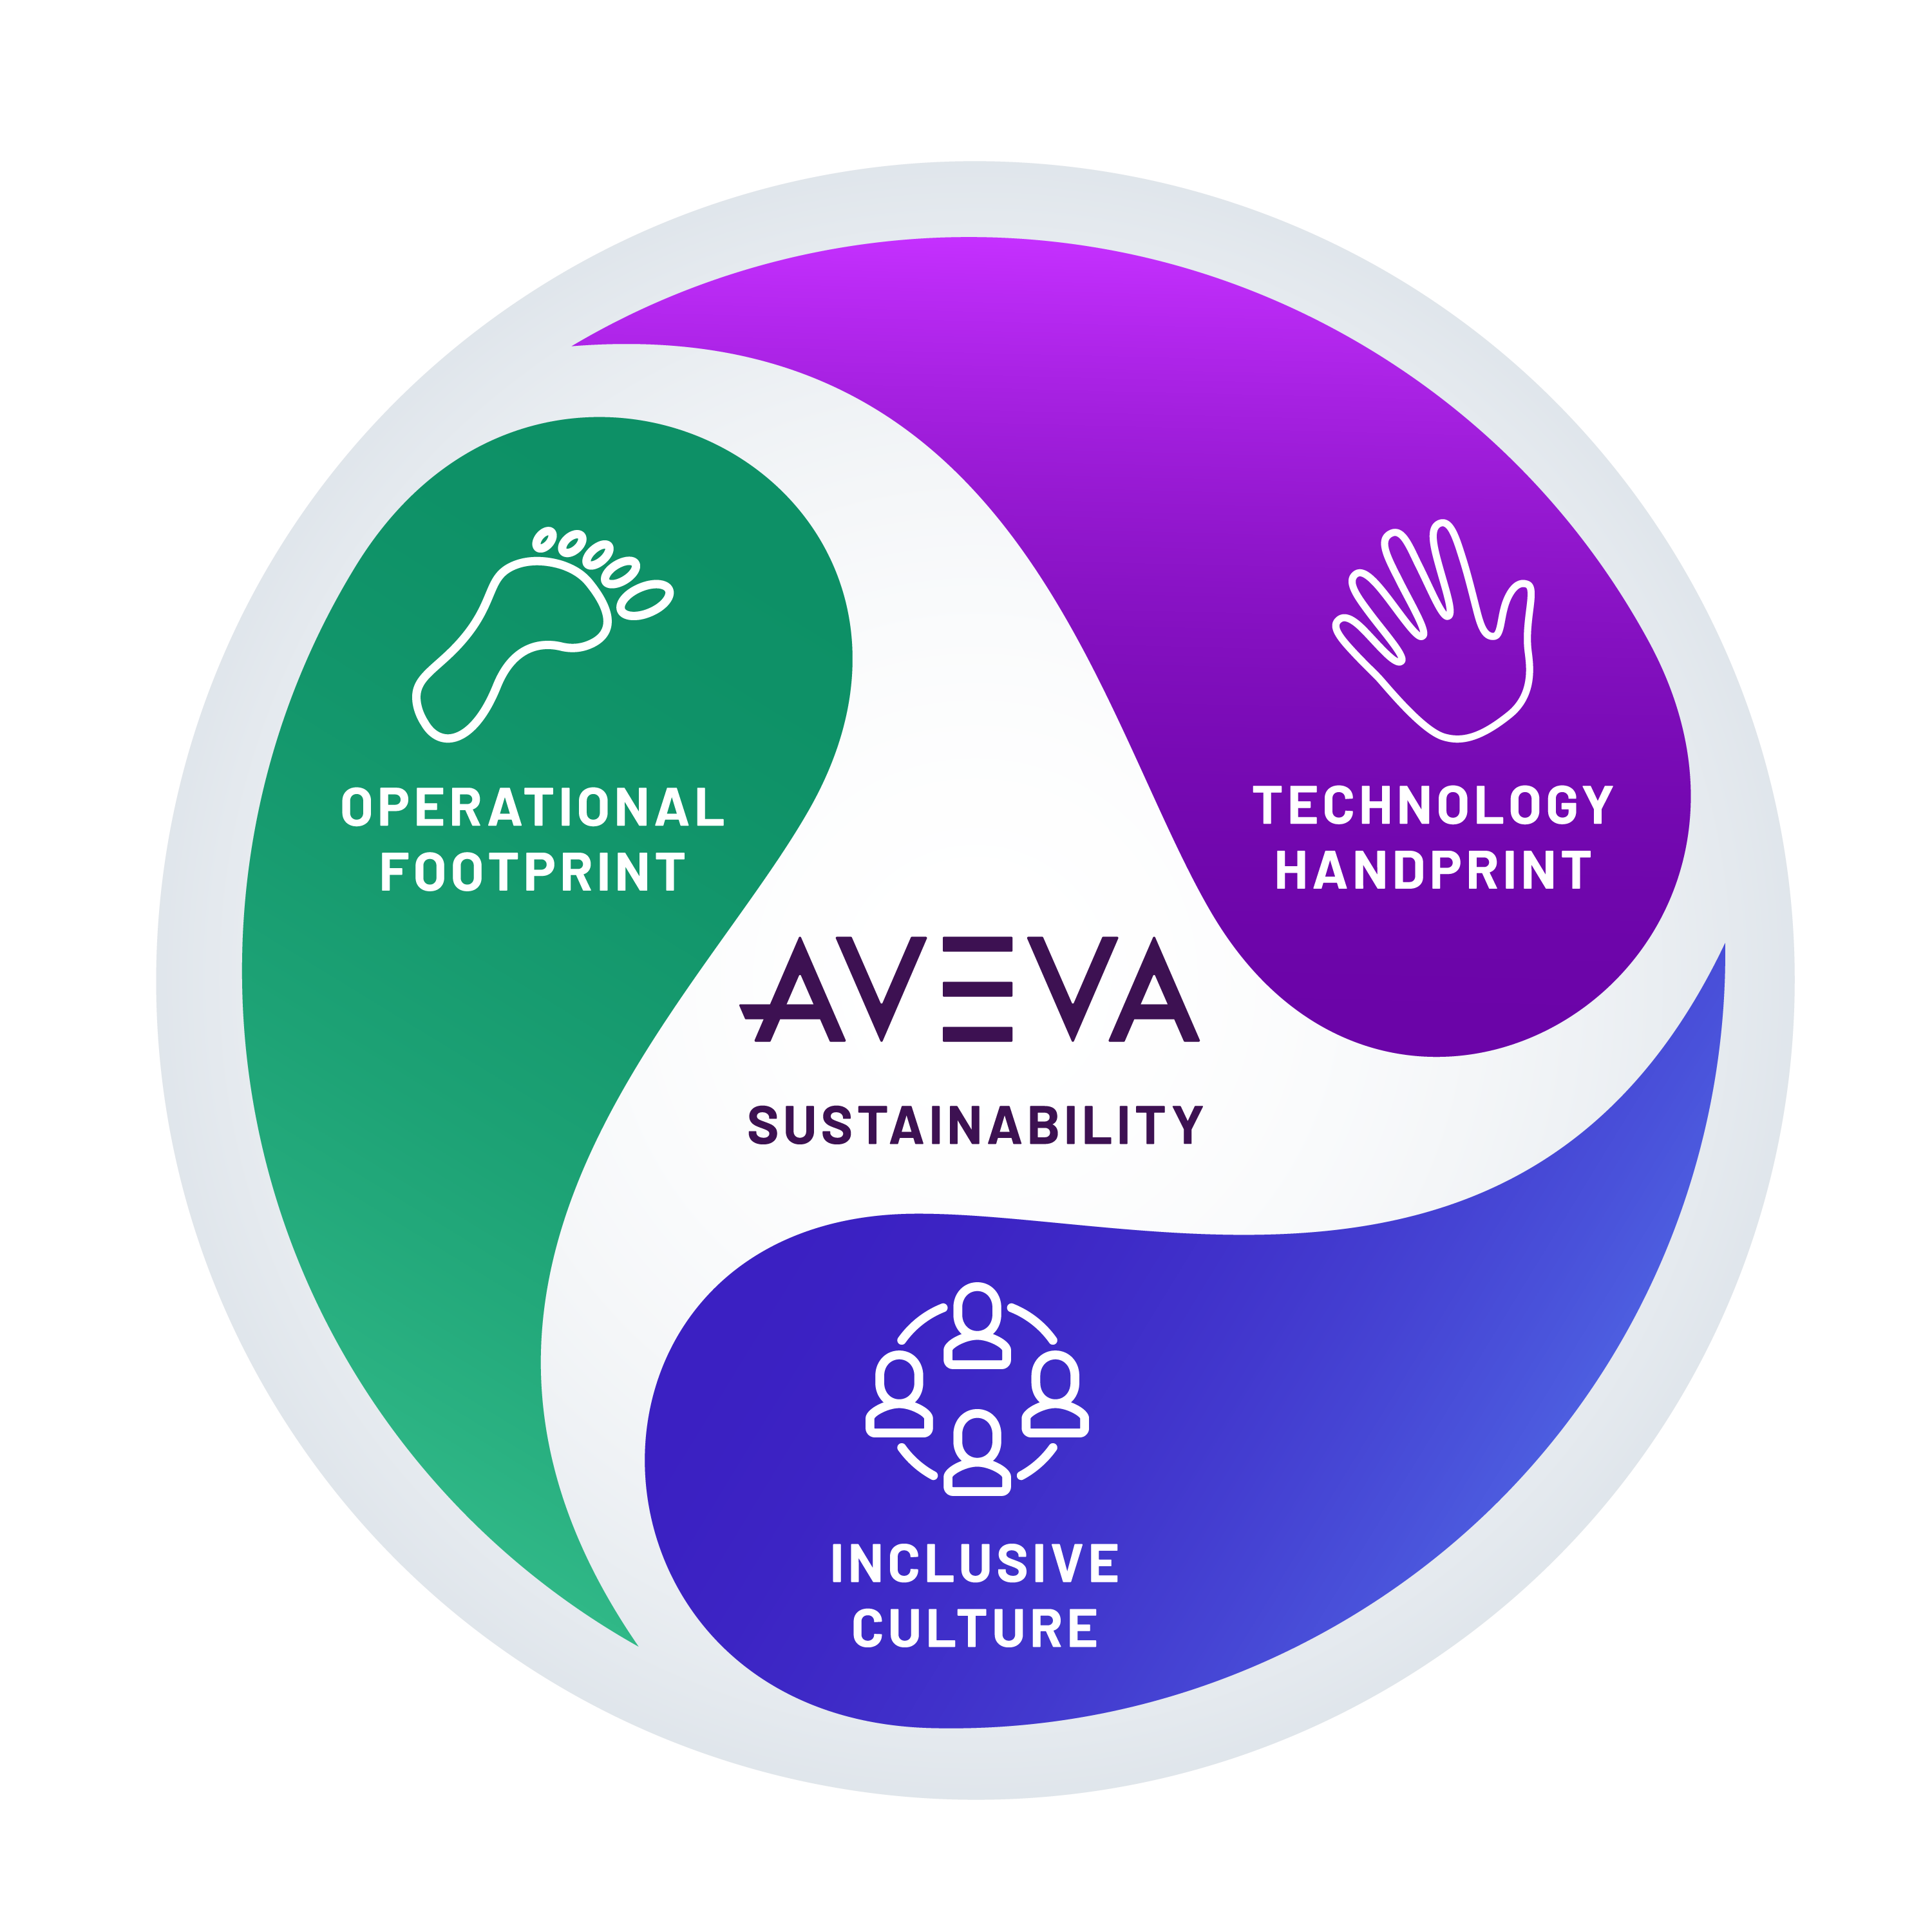





Our integrated ESG vision
We create industrial software that inspires our customers to transform the environmental and social impacts of their business. We strive to exemplify sustainable business practices within our operations. We enable an inclusive and equitable culture for our people and communities.
Notes:
As an industry leader, we know much is expected of us. That is why we have articulated a vision of three ways we can demonstrate leadership across our Environmental, Social and Governance (ESG) agenda:
Our technology handprint - Transforming the energy efficiency, circularity, traceability and resilience of worldwide industries via our secure software​
Our inclusive culture – Enabling a culture of inclusion, wellbeing and opportunity for our people and communities
Our operational footprint - Exemplifying environmental stewardship and ethical business across our value chain​
The actions we take daily to further embed sustainability into our operations, our culture and our core business strategy are guided by our ESG vision.

Slide 8



Our pledge to sustainability leadership
Net Zero Across Operations by 2030
(Scopes 1, 2 and 3)
Advancing Women in Technology
30%
Women in Leadership
40%
Women in Management
50%
Women Hires
8
Notes:
In affirming our commitment to be part of the solution to the climate crisis and fostering a more inclusive and diverse workforce, we are proud to have recently announced our 2030 agenda and associated pledges. These include:
Net Zero Across Operations by 2030: Setting 1.5°C-aligned emission reduction targets across all three Scopes (that is, our own direct emissions as well as the emissions of those who supply our energy and other services) as part of joining the Business Ambition for 1.5°C campaign. The move affirms AVEVA’s commitment to set both short and long-term targets that are in line with the most ambitious aims of the Paris Climate Agreement and reflects a science-based approach to climate action. In addition to leading by example on emissions mitigation, we are speeding up the realization of a net-zero future by enhancing the suite of software solutions we offer our customers to enable them to reduce their carbon footprints.
Advancing Women in Technology with a 30/40/50 Gender Representation by 2030. This commitment affirms our focus on Diversity, Equality and Inclusiveness at AVEVA and ensuring we continue to recognize the importance of attracting, retaining, nurturing and advancing the next generation of women in technology. Like most technology and industrial companies, we know we need to a better job with gender equity in our business. That's why we have established a new gender pay gap target and we are making good progress towards it. During FY20 reduced our global gender pay gap by more than 4%, to 20.4% overall.
AVEVA is proud to be partnering and working with a number of corporate sustainability initiatives that bring together companies to help tackle climate challenges collectively, including BSR, the UN Global Compact, and the Renewable Energy Buyers Alliance (REBA). In signing on to the Business Ambition for 1.5°C commitment, AVEVA is also pleased to be joining the UNFCCC Race to Zero and we are joining the World Economic Forum 2030 alliance, working with companies and businesses to drive the sustainability thought leadership agenda.
We look forward to being part of the UN Climate Change Conference COP26 this year, alongside customers like Wood, GSK, SSE and others.

Slide 9

Questions?
Notes:
Note to presenters: These GIF slides are taken from our brand campaign and are designed to enable you to close off your presentation with a flourish.

